Slide 1
DevOps Training

Slide 2
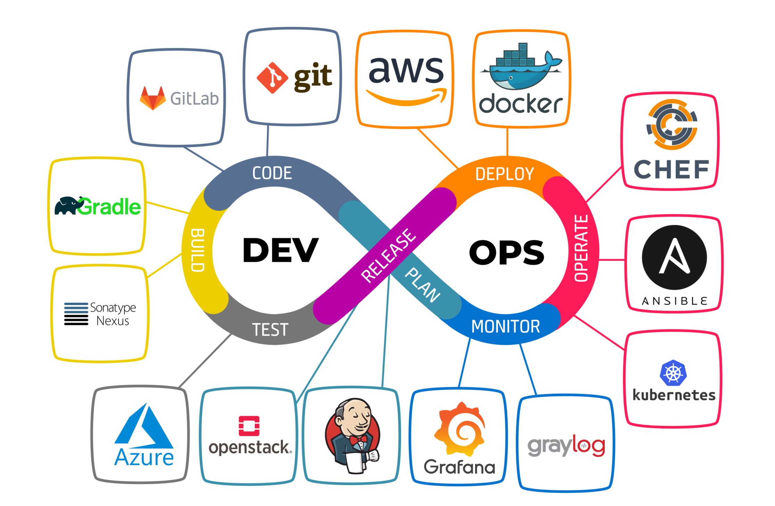
Lifecycle

Slide 3
Tools
Developers push code.
Jenkins
Builds the application.
Sonatype Nexus
Docker
Kubernetes
Configures infrastructure.
Grafana + Prometheus
GitHub
Triggers CI/CD pipeline.
Gradle
Stores dependencies.
Packages the app in a container.
Deploys containers.
Ansible
Monitors system performance.

Slide 4
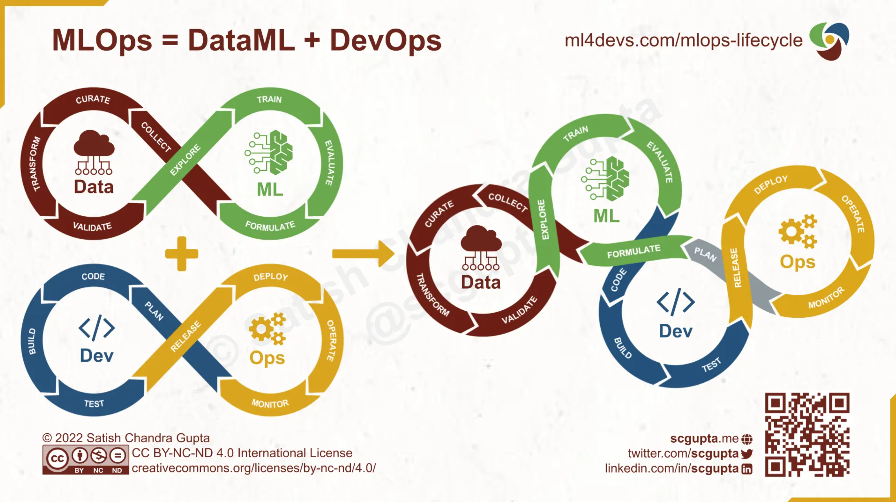
DevOps Vs MLOps
https://www.ml4devs.com/en/articles/mlops-machine-learning-life-cycle/

Slide 5
DevOps Vs MLOps
DevOps Example: Institute Management System
Developer pushes new code to GitHub.
Jenkins CI/CD pipeline builds, tests, and deploys the web application using Docker & Kubernetes.
Grafana & Prometheus monitor system performance.
If an issue arises, DevOps engineers roll back the previous version.
MLOps Example: Student Performance Prediction Model
Data Collection: Fetch attendance & exam records.
Model Training: Train a machine learning model to predict student performance.
Model Validation: Check accuracy & fairness.
Deployment: Deploy the trained model as an API (using Kubeflow).
Monitoring: Track model accuracy in production and retrain when performance drops.

Slide 6
DevOps Vs MLOps
Category | DevOps Tools | MLOps Tools
Version Control | GitHub, GitLab | DVC, MLflow, Pachyderm
CI/CD | Jenkins, GitHub Actions | Kubeflow, TFX, MLflow
Infrastructure | Terraform, Ansible | Kubernetes, Kubeflow Pipelines
Monitoring | Grafana, Prometheus | MLflow, Evidently AI
Testing | Selenium, JUnit | TensorFlow Model Analysis, Great Expectations

